Slide 1
Team 4 paper presentation
Automated Image Caption Generation using Deep Learning
Mahmudul Hasan (20101168)
Mahmudul Hassan (20101368)
Sara Jerin Prithila (21101306)
Tamim Al Ahasan (21101340)
Abid Hossain (ST)
Sania Azhmee Bhuiyan (RA)
1

Slide 2
Introduction
Develop an advanced image caption generator by combining computer vision and natural language processing techniques.
Integrate cutting-edge CNNs for image analysis and LSTMs for language generation.
Workflow Phases:
Dataset Selection: Employ the Flickr dataset to train and evaluate the model.
Model Architecture: Construct a sophisticated CNN-LSTM architecture.
Training Process: Utilize TensorFlow or PyTorch libraries to train the model.
Data Preprocessing: Prepare images (resize, normalize) and text (tokenize) for efficient input.
Deep learning techniques are implemented to generate the captions from images.
2

Slide 3
Related Work
Enhanced Captioning with Image Attributes.
Retrieval-Based Image Captioning as a Retrieval Task.
Deep Learning and Attention for Improved Caption Generation.
3

Slide 4
Methodology
The use of a pre-trained VGG16 encoder for the purpose of object detection.
The approach reduces dependence on the captioner for visual object understanding.
The object detection algorithm is used instead of overloading the image caption generation model.
‹#›

Slide 5
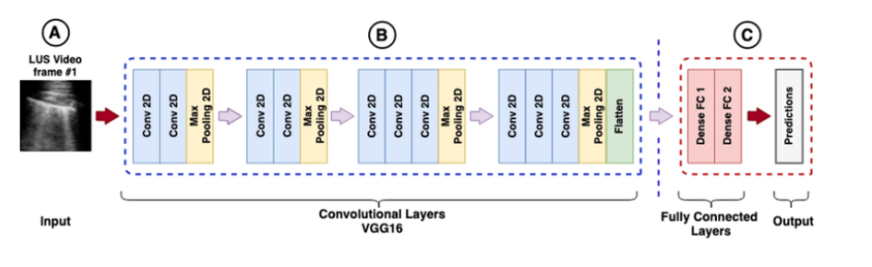
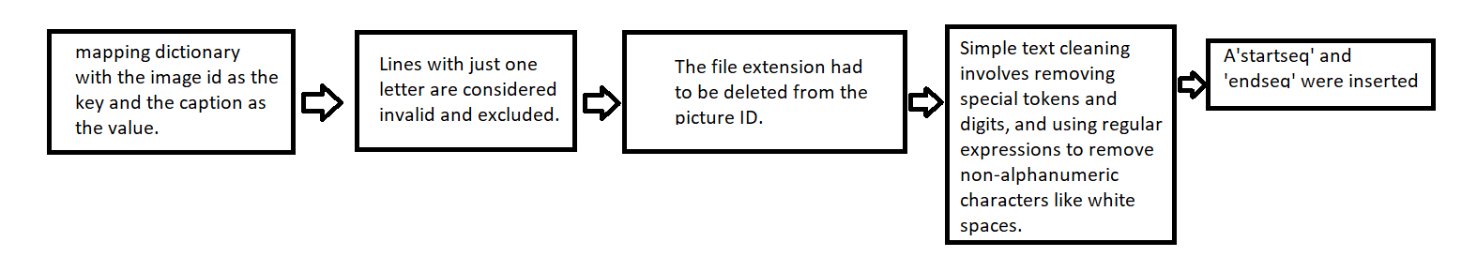
Data Preprocessing
Feature extraction using VGG16
Text Preprocessing
5

Slide 6
MODEL ARCHITECTURE AND TRAINING
Encoder: Pretrained VGG16 model was used as a encoder to extract image features
Object Detection: Architecture and training
Captioning Language Model: Development of a language model that would be responsible for taking in the learned image features and to generate a caption from said features
Caption generation: Algorithm-1 was used to generate captions
6

Slide 7
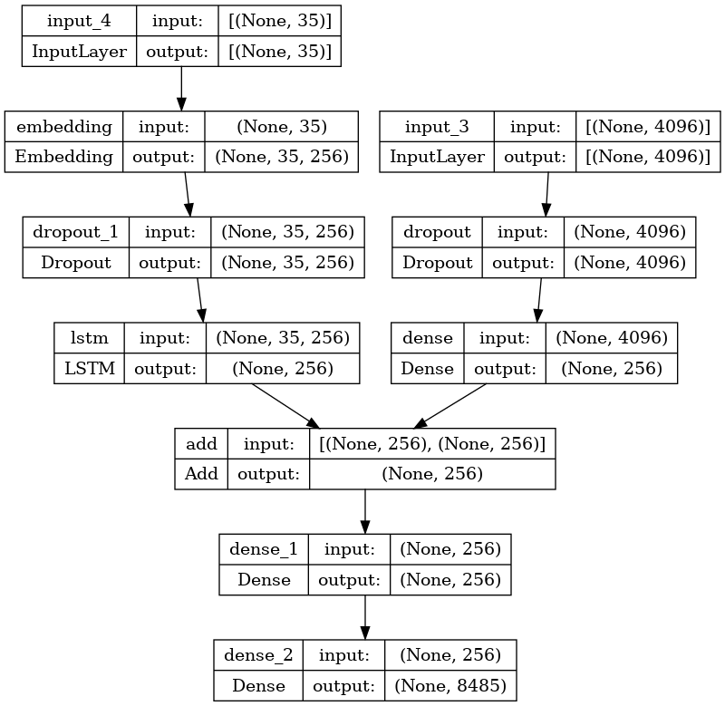
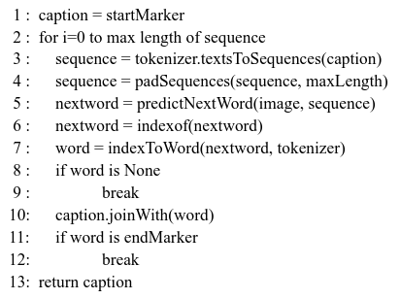
Block diagram of the model
Algorithm 1: caption generation
7

Slide 8
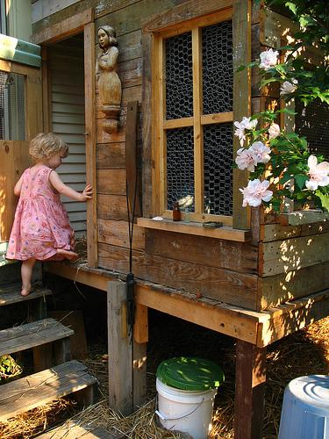
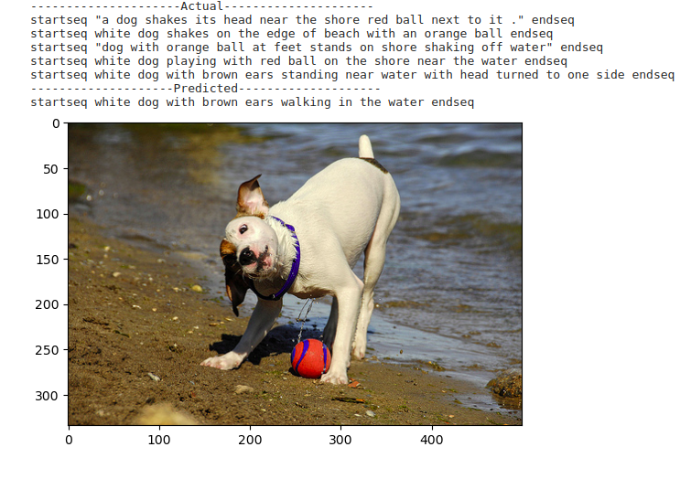
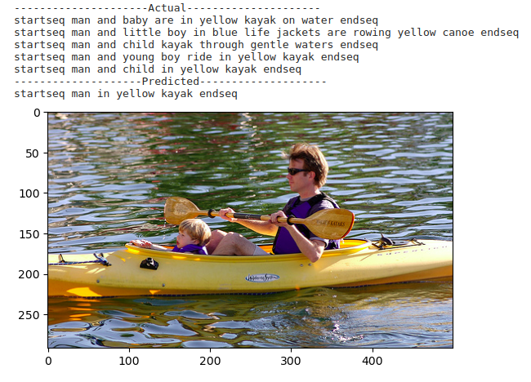
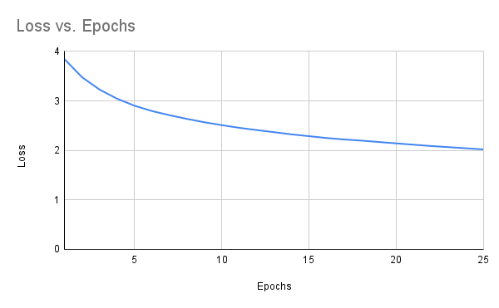
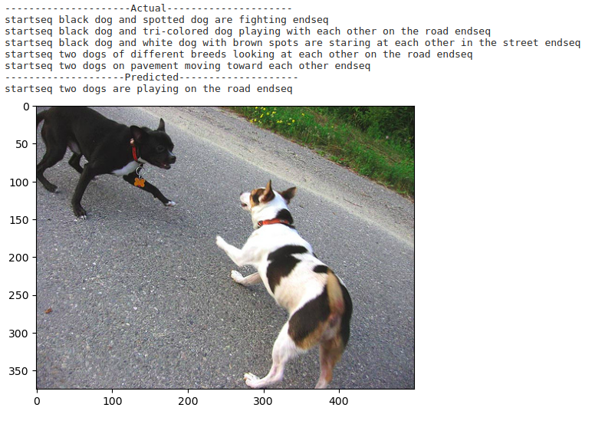
Results and Analysis
BLEU-1: 0.532258
BLEU-2: 0.305608
'A child in a pink dress is climbing up a set of stairs in an entryway .',
'A girl going into a wooden building .',
'A little girl climbing into a wooden playhouse .',
'A little girl climbing the stairs to her playhouse .',
'A little girl in a pink dress going into a wooden cabin .'
8

